Slide 1


Lecture 05
Irfan Malik
Dr. Sheraz Naseer

Slide 2
Agenda
Prompt Engineering
Chat GPT PlayGround

Slide 3
Previous lecture:
Lecture 04 - Deep Dive into Generative AI
Click Here

Slide 4
Basics of NLP

Slide 5
Stemming vs Lemmatization
Stemming | Lemmatization
Removing the last few characters of a given word, to obtain a shorter form, often leading to incorrect meanings and spelling | Lemmatization considers the context and converts the word to its meaningful short form
For example: Stemming the word ‘Caring’ would return ‘Car’ | For example: lemmatizing the word ‘Caring’ would return ‘Care’

Slide 6
Introduction to ChatGPT
ChatGPT stands for Generative Pretrained Transformer.
ChatGPT is an advanced AI language model developed by OpenAI.
ChatGPT revolutionizes Natural Language Processing.

Slide 7
Applications of ChatGPT
Content Generation
Text Summarization
Chatbots, Virtual Assistants, and Customer Support (Question Answering)
Language Translation
Interactive Storytelling
Education and Tutoring

Slide 8
Step 1: Accessing chat.openai
To begin, open your preferred web browser and navigate to the chat.openai website. The website URL is https://chat.openai.com/auth/login .

Slide 9
Step 2: Creating an Account
If you already have an account, you can skip this step and proceed to Step 3. If not, you will need to create a new account.
Look for the "Sign Up" or "Register" button on the login page and click on it.
Click on “Continue with Google”, and then select your Google account.
Follow the on-screen instructions to open the dashboard.

Slide 10
Step 3: Logging In
Click on the "Log In" button to access your chat.openai account.
Click on “Continue with Google”, and then select your google account.

Slide 11
Step 4: Engaging in Conversation
In the chat interface, you will see a text input box where you can type your message or question.
Simply enter your text and press "Enter" or click the send button to send your query to the AI model.
Once you've sent your message, the AI model will process it and generate a response.

Slide 12
Generative AI

Slide 13
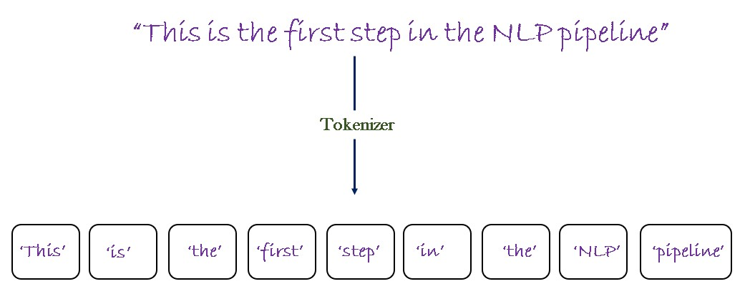
Tokenization
Definition: Tokenization is the process of breaking down text into smaller units called tokens, which can be words, phrases, or even characters.

Slide 14
Tokens in Language Models
Definition: Tokens are the fundamental units of text used by language models. They can be as short as a single character or as long as a word or phrase.
Importance: Language models process text at the token level, allowing them to analyze and generate text based on the context and relationships between individual tokens.

Slide 15
Prompt Engineering

Slide 16
What is Prompt Engineering?
Prompt engineering involves crafting tailored instructions or queries to guide the language model towards desired outputs.
It helps shape the behavior of the model and improves response quality.

Slide 17
Anatomy of Prompt
Definition: In the context of language models, a prompt refers to the input or instruction provided to the model to generate a specific response or output
Parts of a Good Prompt (Not all are necessary for each and every prompt)
Simulate Persona
Task
Steps to complete Task
Context/Constraints
Goal
Format Output

Slide 18
Prompt Limits in Language Models
Definition: Prompt limits refer to the constraints imposed on the input provided to a language model.
Reasons for Prompt Limits:
Memory limitations: Language models have a finite capacity to process and store information.
Computational constraints: Longer prompts require more processing time and computational resources.
Response coherence: Extremely long prompts may result in irrelevant outputs.

Slide 19
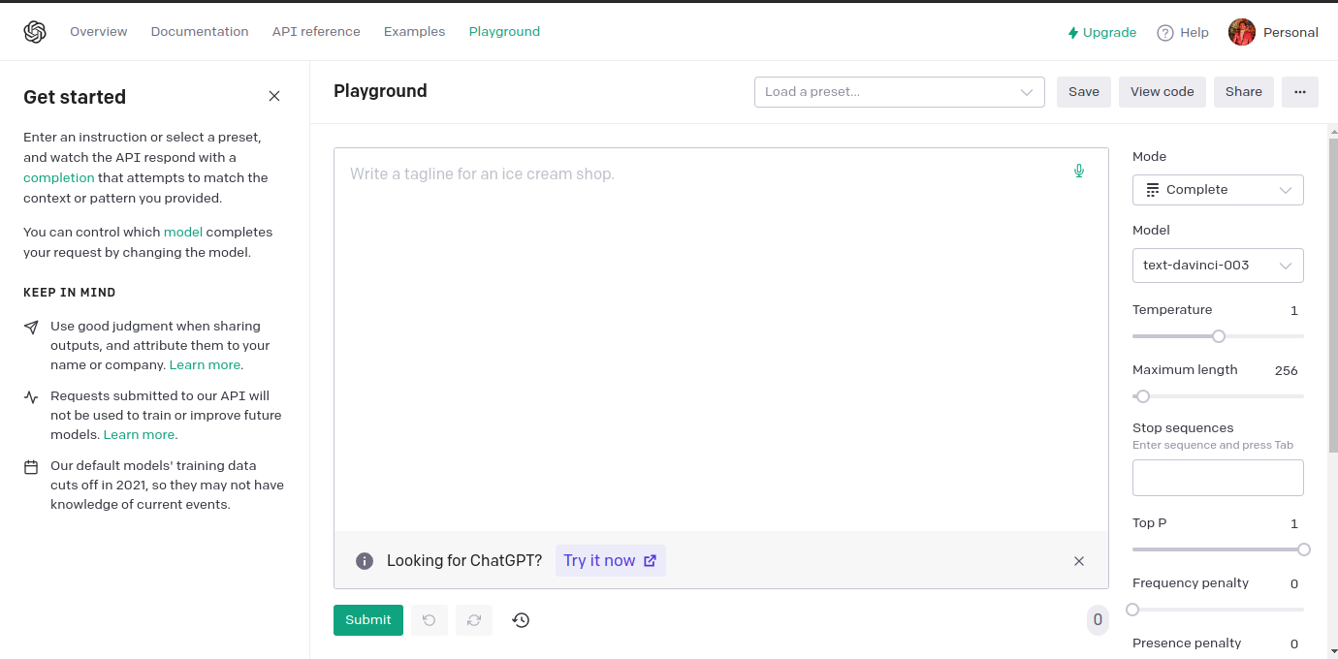
OpenAI Playground

Slide 20
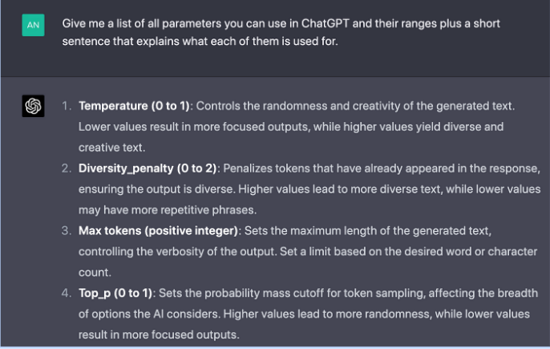
A Brief Overview

Slide 21
Prompting Example 01
Simulate Persona: You are a customer service representative for a tech company.
Task: Assist a customer in resolving a software issue.
Steps to complete Task:
Greet the customer and ask for details about the issue.
Provide step-by-step instructions to troubleshoot the problem.
If the issue persists, escalate it to the technical support team.

Slide 22
Context/Constraints: The customer is not tech-savvy, and you must communicate in a friendly and non-technical manner.
Goal: Resolve the customer's issue satisfactorily.
Format Output: Provide a summary of the troubleshooting steps and any additional information the customer might need.

Slide 23
Prompting Example 02
Simulate Persona: Imagine you are a mentor guiding a group of individuals new to prompt engineering.
Task: Identify and address common issues in prompt creation to improve overall effectiveness.
Steps to complete Task:
Analyze the prompt for Simulate Persona, Task, Steps to complete Task, Context/constraints, goals and Format Output
Identify and rectify instances of ambiguity or vagueness in prompt language.
Ensure that prompts provide sufficient information for the desired task without unnecessary complexity.

Slide 24
Context/Constraints: Consider the diverse backgrounds and skill levels of those engaging with the prompts.
Goal: Enhance the quality of prompts by eliminating potential sources of confusion or misinterpretation.
Format Output: Provide a revised version of a poorly constructed prompt, highlighting the changes made and explaining how each modification contributes to better prompt engineering.

Slide 25
Context in Prompting
Definition: Context refers to the information and preceding text that informs the language model about the desired output or influences its response.
Role of Context:
Context: helps shape the model's behavior and generate more accurate responses.
Relevance: Context ensures continuity and relevance in the generated text.
Interpretation: The language model uses context to understand the desired meaning and tone of the prompt.

Slide 26
Tips for Effective Prompt Engineering
Be explicit: Clearly specify the desired format or output.
Provide context: Offer relevant information or background to guide the model.
Control output length: Instruct the model to generate responses of a specific length.
Restrict responses: Utilize techniques like temperature adjustment to refine output quality.
Experiment and iterate: Refine prompts through experimentation and feedback loops.

Slide 27
Scenario 1: Essay Writing For Students
Step 1 (Bad Prompt): "Write an essay about your favorite hobby."
Step 2 (Refined Prompt): "Write an engaging essay describing how your favorite hobby has positively influenced your personal growth and development."
Step 3 (Further Refinement): "Write an insightful essay explaining how your favorite hobby, such as playing a musical instrument, has enhanced your problem-solving skills, increased your patience, and boosted your self-confidence."

Slide 28
Scenario 2: Historical Event Analysis
Step 1 (Bad Prompt): "Analyze the causes of World War II."
Step 2 (Refined Prompt): "Provide a comprehensive analysis of the political, economic, and social factors that contributed to the outbreak of World War II, considering both domestic and international influences."
Step 3 (Further Refinement): "Compose a well-structured and nuanced analysis of the immediate triggers and long-term underlying causes of World War II, highlighting key events and decisions that escalated tensions and ultimately led to the global conflict."

Slide 29
Chat GPT PlayGround

Slide 30
Summary
Prompt Engineering
Best Practices
ChatGPT PlayGround
Sample prompt practise

Slide 31
Next Lecture:
Lecture 06 - Diffusion Models
Click Here

